Slide 1
ECE752 Project Presentation
Coalescing Multiple Loads to Reduce Memory Traffic
Vanshika Baoni Ishan Yelurwar
Prathamesh Patel Adarsh Mittal
“There are only two hard things in Computer Science: cache invalidation and naming things”.
-- Phil Karlton

Slide 2

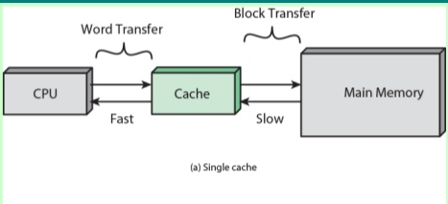

Motivation:
Memory Bandwidth is still a challenge
Memory is the bottleneck for most architectures
Roughly, 40% memory instructions (Load = 25% & Store = 15%)
Load Requests typically fetch close-by or consecutive addresses
Idea:
Combine multiple loads that maps to same cache block

Slide 3
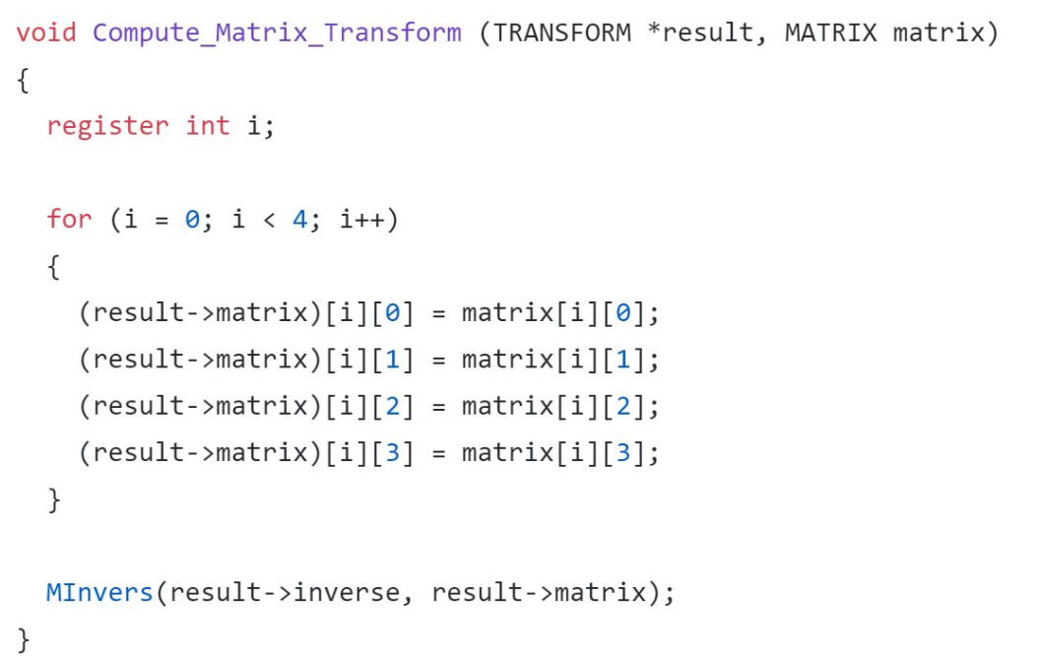
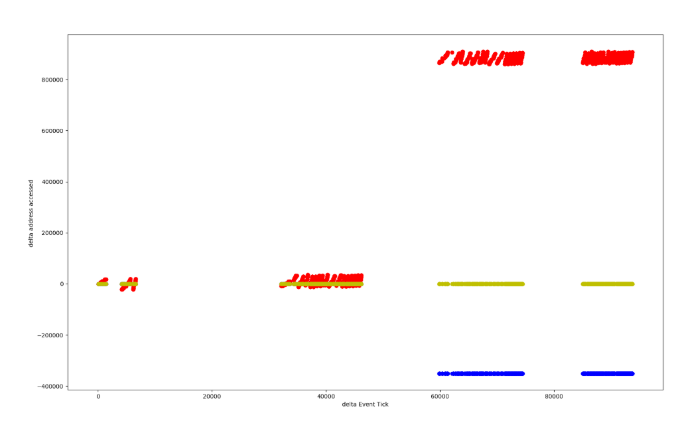
Preliminary Analysis:

Slide 4
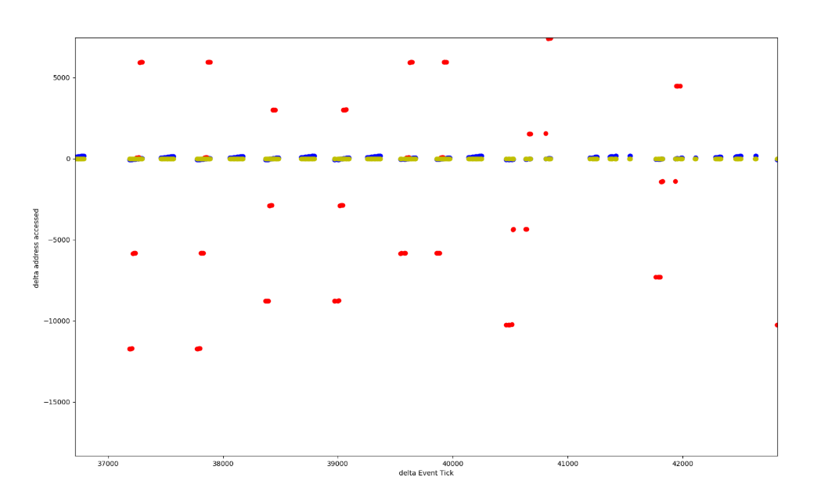
Preliminary Analysis:

Slide 5
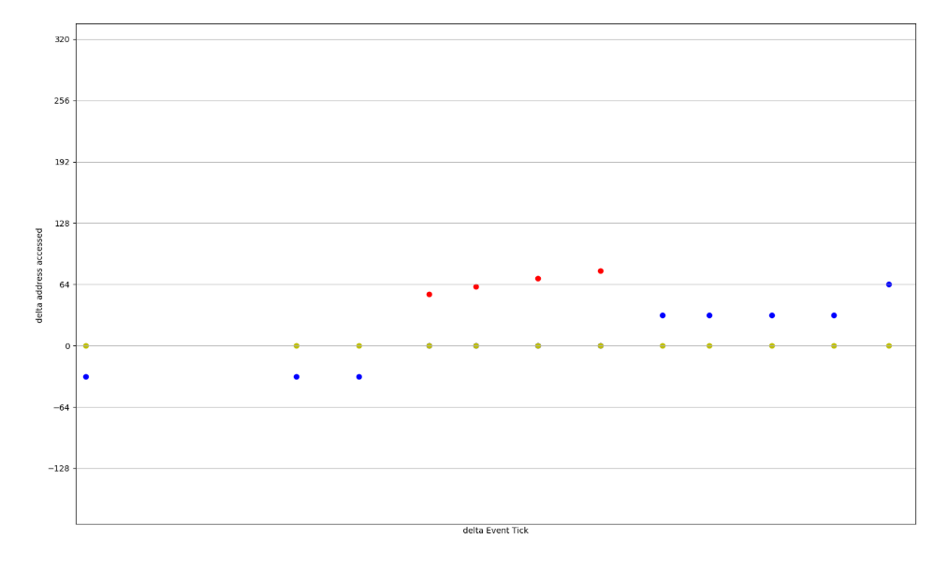
Preliminary Analysis:

Slide 6
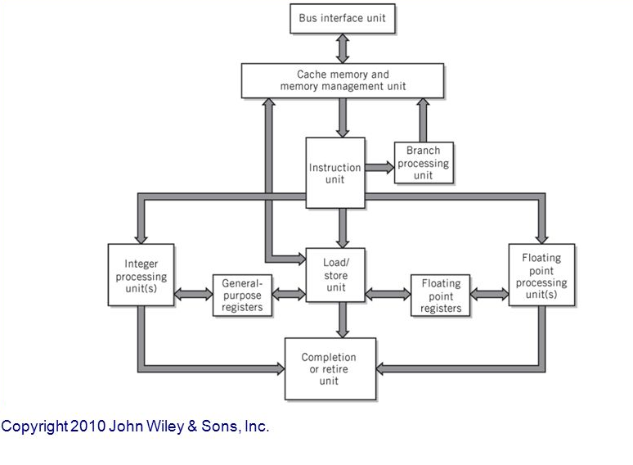
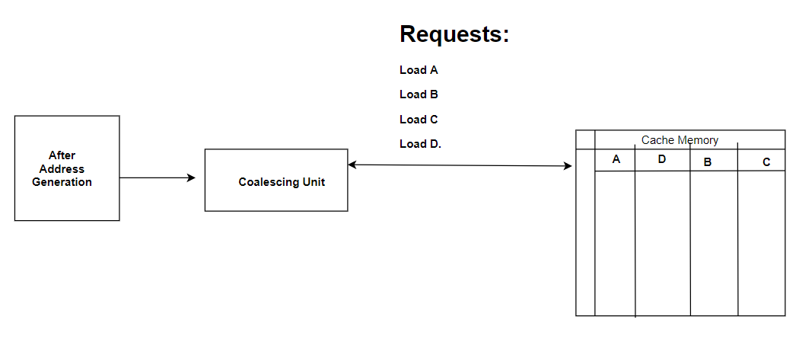
Our Solution:
Load Coalescing Unit (LCU) – essentially a buffer – to service load data and bypass cache access

Slide 7
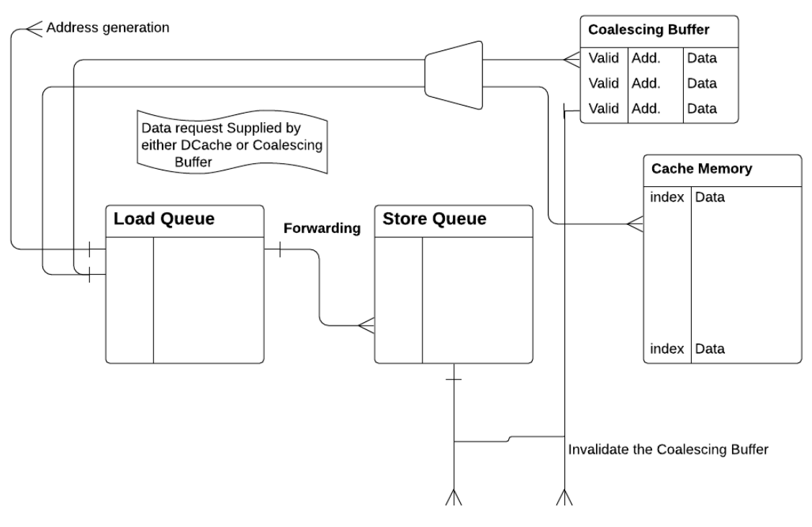
Architecture of Load Coalescing Unit (LCU)

Slide 8
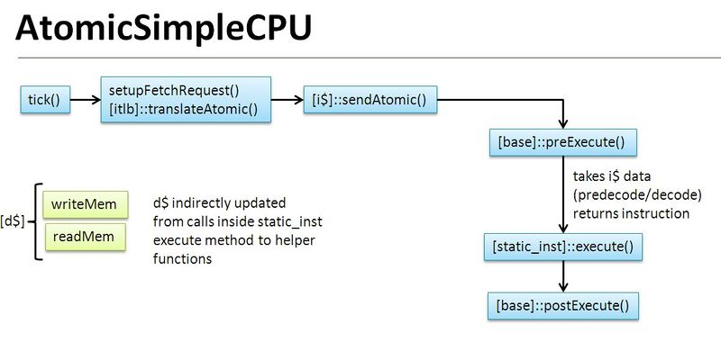
Implementation: Gem5
CPU Models:
Atomic Simple
Eviction Policy:
FIFO
LRU
Random
NMRU
`

Slide 9
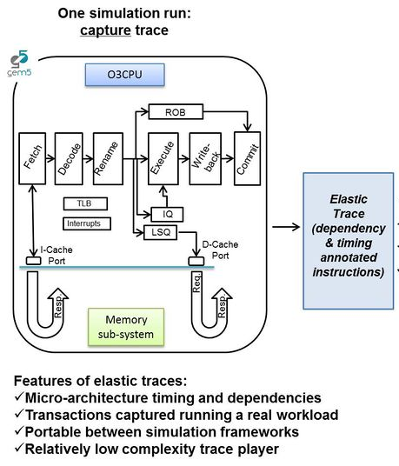
Implementation: Gem5
CPU Models:
Out of Order (O3)
Eviction Policy:
FIFO
LRU
Random
NMRU
`

Slide 10
Implementation: Challenges
Benchmark Evaluation
Cold start & inconsistencies
Load-Store Handling
Load-Store Aliasing
Communication between LCU and D-Cache

Slide 11
Implementation: Challenges
Benchmark Evaluation
Cold start & inconsistencies
Load-Store Handling
Load-Store Aliasing
Communication between LCU and D-Cache
Figuring out benchmarks
Checkpointing
Fast Forwarding

Slide 12
Implementation: Challenges
Instruction Order:
Store $3
Load $1
Load $3
Benchmark Evaluation
Cold start & inconsistencies
Load-Store Handling
Load-Store Aliasing
Communication between LCU and D-Cache
IEW Stage:
Load $1 -> Update coalescing buffer with cache line
Store $3 -> in store queue
Load $3 -> Fetch data (forwarding) from Store Queue
IEW Stage:
Load $1 -> Update coalescing buffer with cache line
Store $3 -> Commit
Load $3 -> Fetch data from buffer

Slide 13
Implementation: Challenges
Instruction Order:
Store $3
Load $1
Load $3
Benchmark Evaluation
Cold start & inconsistencies
Load-Store Handling
Load-Store Aliasing
Communication between LCU and D-Cache
IEW Stage:
Load $1 -> Update coalescing buffer with cache line
Store $3 -> in store queue
Load $3 -> Fetch data (forwarding) from Store Queue
IEW Stage:
Load $1 -> Update coalescing buffer with cache line
Store $3 -> Commit
Load $3 -> Fetch data from buffer

Slide 14
Implementation: Challenges
Instruction Order:
Store $3
Load $1
Load $3
Benchmark Evaluation
Cold start & inconsistencies
Load-Store Handling
Load-Store Aliasing
Communication between LCU and D-Cache
IEW Stage:
Load $1 -> Update coalescing buffer with cache line
Store $3 -> in store queue
Load $3 -> Fetch data (forwarding) from Store Queue
IEW Stage:
Load $1 -> Update coalescing buffer with cache line
Store $3 -> Commit
Load $3 -> Fetch data from buffer

Slide 15
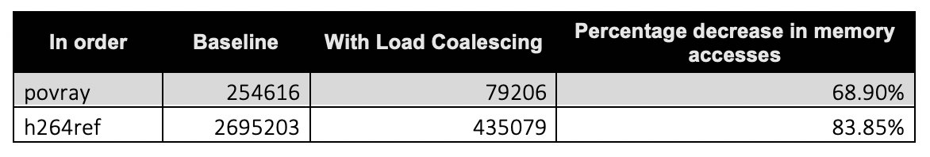
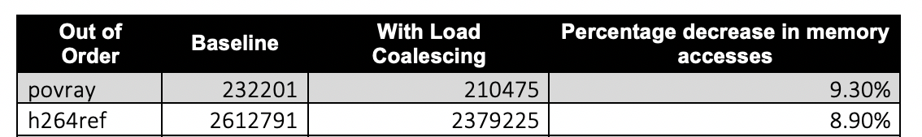
Results:
Benchmarks used: povray, h264ref
Performance evaluated in terms of the reduction in accesses to memory

Slide 16
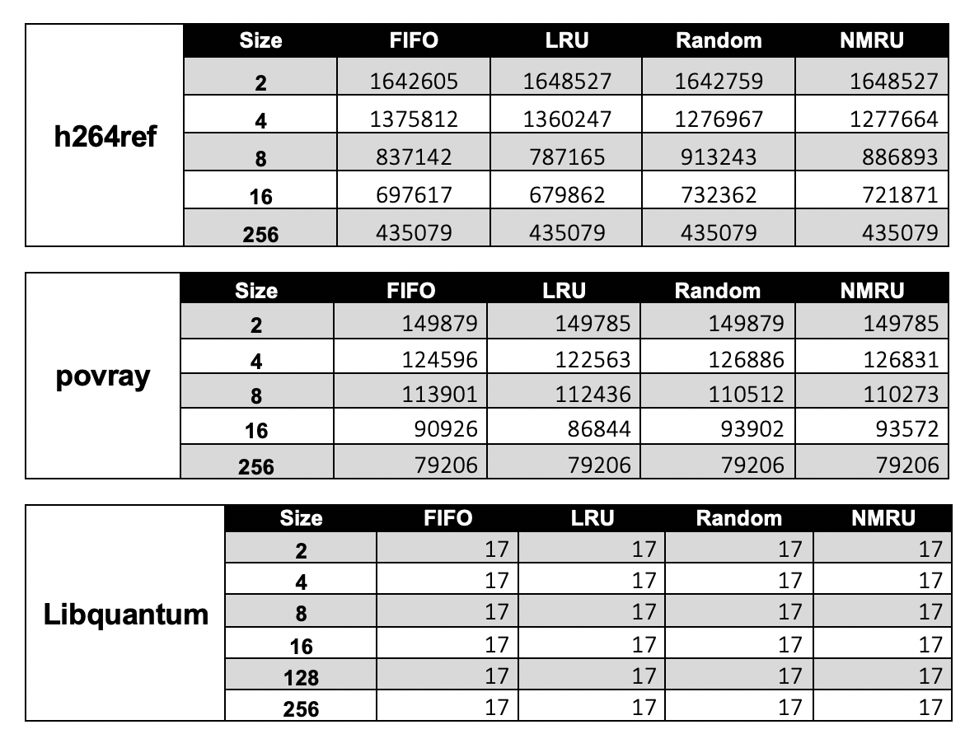
More Results...

Slide 17
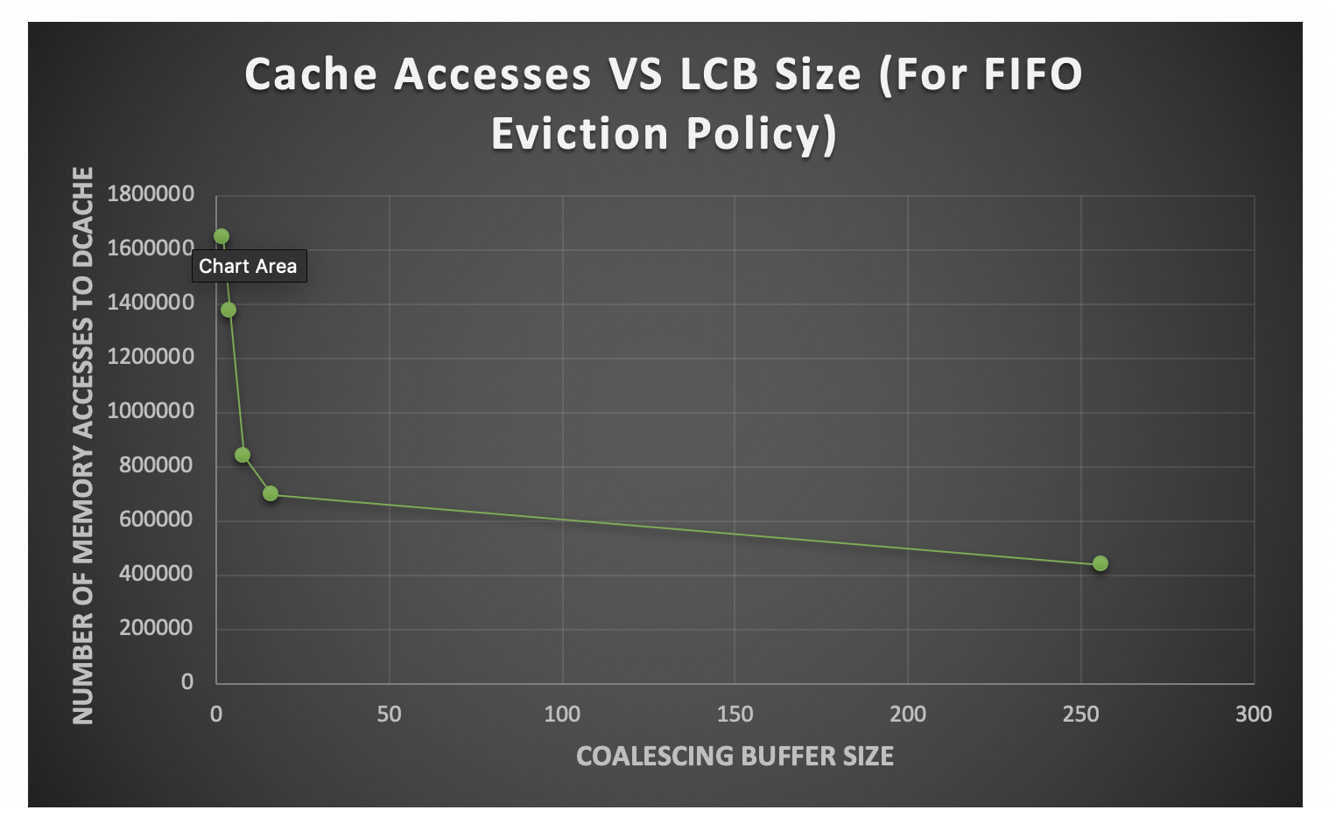

Slide 18
Future Work
Use Register File instead of LCU
Measure the effect of LCU on the size of the blocks:
IQ
LSQ
ROB
L1 Cache
Speculation for Coalescing loads
Prediction scheme for Speculation

Slide 19
Thank you!
Prof. Mikko Lipasti
Prof. Guri Sohi Shyam Murthy
Special thanks to GEM5 (For making our lives easier!)

